Slide 1
Macroeconomics ECON 101
Aggregate Demand and Aggregate Supply Analysis
(Chapter 9)
Instructor: Muhebullah Karimzada
Notes:
If this PowerPoint presentation contains mathematical equations, you may need to check that your computer has the following installed:
1) MathType Plugin
2) Math Player (free versions available)
3) NVDA Reader (free versions available)

Slide 2
Chapter Outline
9.1 Aggregate Demand
9.2 Aggregate Supply
9.3 Macroeconomic Equilibrium in the Long Run and the Short Run

Slide 3
Aggregate Demand
9.1 Learning Objective
Identify the determinants of aggregate demand and distinguish between a movement along the aggregate demand curve and a shift of the curve.
Real GDP has four components:
Consumption (C)
Investment (I)
Government purchases (G)
Net exports (NX)
Adding these gives real GDP:
Government purchases are generally determined by the decisions of policymakers and are independent of changes in the price level.
However, consumption, investment, and net exports are affected by changes in the price level. We will examine each in turn.

Slide 4
Aggregate Demand and Aggregate Supply Model
We have modeled long-run economic growth and also how real GDP is determined in the short run.
In this chapter we will extend the model of the economy in the short run to be able to understand why real GDP, the level of employment, and the price level fluctuate.
Our tool for doing this will be the aggregate demand and aggregate supply model; to build the model, we must determine how aggregate demand and aggregate supply are each formed.
Aggregate demand and aggregate supply model: A model that explains short-run fluctuations in real GDP and the price level.

Slide 5
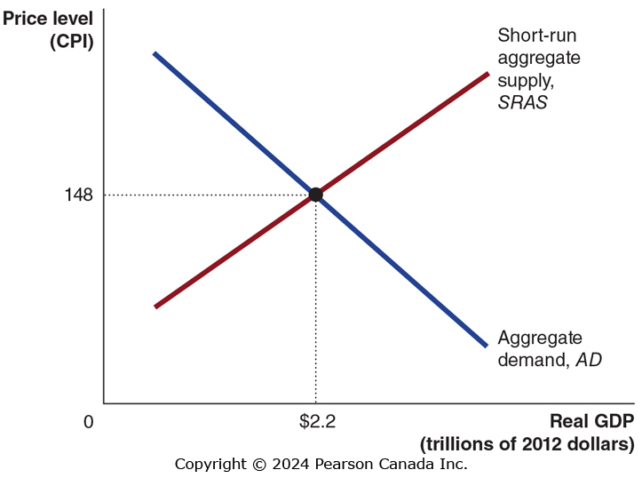
Figure 9.1 Aggregate Demand and Aggregate Supply
In the short run, real GDP and the price level are determined by the intersection of the aggregate demand (AD) curve and the short-run aggregate supply (SRAS) curve.
Aggregate demand (AD) curve: A curve that shows the relationship between the price level and the quantity of real GDP demanded by households, firms, and the government.
Short-run aggregate supply (SRAS) curve: A curve that shows the relationship in the short run between the price level and the quantity of real GDP supplied by firms.

Slide 6
The Wealth Effect: How a Change in the Price Level Affects Consumption
Household consumption is mostly determined by income, but it is also affected by wealth.
Some household wealth is held in nominal assets; so as price levels rise, the real value of household wealth declines. This results in less consumption.
Implication: higher price level leads to lower consumption.

Slide 7
The Interest-Rate Effect: How a Change in the Price Level Affects Investment
When prices rise, households and firms need more money to finance buying and selling.
So, households and firms borrow and withdraw funds from banks and sell financial assets such as bonds in order to have more funds available.
This increase in demand for money causes the “price” of holding money (the interest rate) to rise, discouraging firm investment.
Implication: higher price level leads to lower investment.

Slide 8
The International-Trade Effect: How a Change in the Price Level Affects Net Exports
When Canadian price levels rise, Canadian exports become more expensive and imports become relatively cheaper.
Fewer exports and more imports means net exports falls.
Implication: higher price level leads to lower net exports.
Each of the three effects shows higher price levels leading to lower values of components of real GDP.
This establishes that the aggregate demand curve slopes downward.

Slide 9
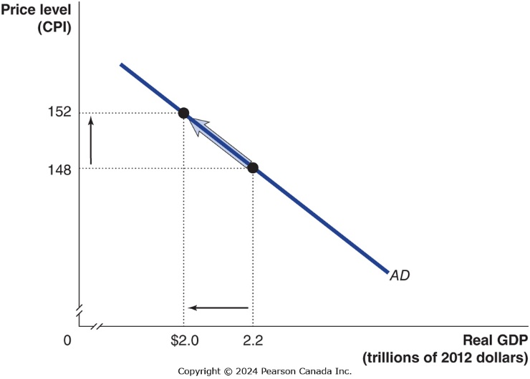
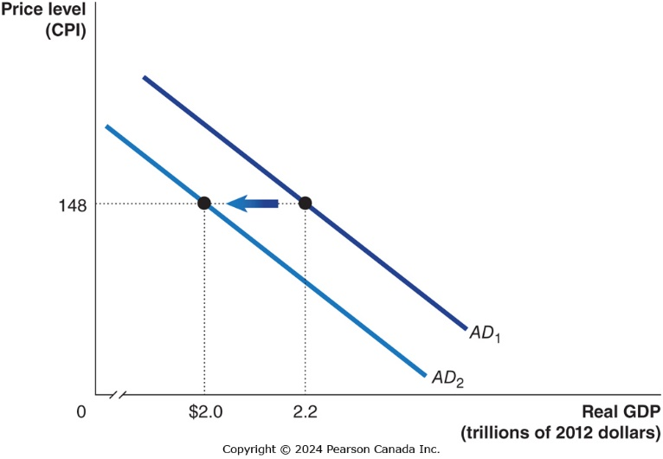
Shifts of the AD Curve vs. Movements Along It
The aggregate demand curve shows the relationship between the price level and real GDP demanded, holding everything else constant.
A change in the price level not caused by a change in a component of real GDP results in a movement along the AD curve.
A change in some component of aggregate demand, on the other hand, will shift the AD curve.
Notes:
Long Description:
The line graph with the x-axis labeled real GDP in trillions of 2012 dollars and the y-axis labeled price level in CPI. A line labeled cap AD forms a downward slope with points (1.4, 127) and (1.6, 123) lying on it. An arrow flows from the point (1.6, 123) to the point (1.4, 127).
Long Description:
The line graph with the x-axis labeled real GDP in trillions of 2012 dollars and the y-axis labeled price level in CPI. A line labeled cap AD sub 1 forms a downward slope with a point (1.6, 123) lying on it. A line labeled cap AD sub 2 forms a downward slope with a point (1.4, 123) lying on it parallel to the line cap AD sub 1. An arrow flows from the line cap AD sub 1 to cap AD sub 2.

Slide 10
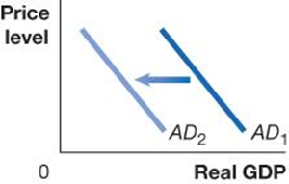
Table 9.1 Variables That Shift the Aggregate Demand Curve (1 of 4)
An increase in … | shifts the aggregate demand curve … | because …
interest rates | On a graph, X is real G D P, and Y is price level. Line A D sub 1 shifts left and becomes A D sub 2. | higher interest rates raise the cost to households and firms of borrowing, reducing consumption and investment spending.
A government policy change could shift aggregate demand. There are two categories of government policies here:
Monetary policy: The actions the Federal Reserve takes to manage the money supply and interest rates to pursue macroeconomic policy objectives.
If the Bank of Canada causes interest rates to rise, investment spending will fall; if it causes interest rates to fall, investment spending will rise.
Notes:
Long Description:
The table shows three columns named an increase in, shifts the AD curve, and because respectively. The data in first column reads interest rates. The shift in AD curve shows a line graph with the horizontal axis labeled real GDP, and the vertical axis labeled price level. There are two parallel lines that are like forward slash across this graph. The inclined line on the right side is dark and is named AD sub 1, and that on the left is faded and is named AD sub 2. There is an arrow to the left, between the two inclined parallel lines. The third column of the table reads “higher interest rates raise the cost to firms and households of borrowing, reducing consumption and investment.”

Slide 11
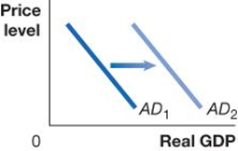
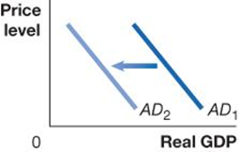
Table 9.1 Variables That Shift the Aggregate Demand Curve (2 of 4)
An increase in … | shifts the aggregate demand curve … | because …
government purchases | On a graph, X is real G D P, and Y is price level. Line A D sub 1 shifts right and becomes A D sub 2. | government purchases are a component of aggregate demand.
personal income taxes or business taxes | On a graph, X is real G D P, and Y is price level. Line A D sub 1 shifts left and becomes A D sub 2. | consumption spending falls when personal taxes rise, and investment falls when business taxes rise.
Fiscal policy: Changes in federal taxes and purchases that are intended to achieve macroeconomic policy objectives.
Increasing or decreasing personal income taxes affects disposable income and hence consumption. The government can also alter its level of government purchases. It could also alter business taxes, affecting the level of investment spending.
Notes:
Long Description:
The table shows two cases for shift in AD curves. The line graphs have real GDP marked along the horizontal axis, and price level along the vertical axis.
Case 1: The data in the first column reads “government purchases.” The second column shows a line graph that shows shift in AD curve. There are two parallel lines that are like forward slash across this graph. The inclined line on the right side is faded and is named AD sub 2, and that on the left is dark and is named AD sub 1. There is an arrow to the right, between the two inclined parallel lines. The third column of the table reads “government purchases are a component of aggregate demand.”
Case 2: The data in the first column reads “personal income taxes or business taxes.” The second column shows a line graph that shows shift in AD curve. There are two parallel lines that are like forward slash across this graph. The inclined line on the right side is dark and is named AD sub 1, and that on the left side is faded and is named AD sub 2. There is an arrow to the left, between the two inclined parallel lines. The third column of the table reads “consumption spending falls when personal taxes rise, and investment falls when business taxes rise.”

Slide 12
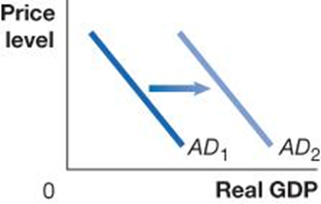

Table 9.1 Variables That Shift the Aggregate Demand Curve (3 of 4)
An increase in … | shifts the aggregate demand curve … | because …
households’ expectations of their future incomes | On a graph, X is real G D P, and Y is price level. Line A D sub 1 shifts right and becomes A D sub 2. | consumption spending and the residential investment component of investment spending increase.
firms’ expectations of the future profitability of investment spending | On a graph, X is real G D P, and Y is price level. Line A D sub 1 shifts right and becomes A D sub 2. | investment spending increases.
Households or firms could become more optimistic about the future, increasing consumption or investment respectively.
The opposite is true if households and firms are pessimistic.
Notes:
Long Description:
The table shows two cases for shift in AD curves. The line graphs have real GDP marked along the horizontal axis, and price level along the vertical axis.
Case 1: The data in the first column reads “households’ expectations of future income.” The second column shows a line graph that shows shift in AD curve. There are two parallel lines that are like forward slash across this graph. The inclined line on the right side is faded and is named AD sub 2, and that on the left is dark and is named AD sub 1. There is an arrow to the right, between the two inclined parallel lines. The third column of the table reads “consumption spending increases.”
Case 2: The data in the first column reads “firms’ expectations of the future profitability of investments.” The second column shows a line graph that shows shift in AD curve. There are two parallel lines that are like forward slash across this graph. The inclined line on the right side is faded and is named AD sub 2, and that on the left is dark and is named AD sub 1. There is an arrow to the right, between the two inclined parallel lines. The third column of the table reads “investment spending increases.”

Slide 13
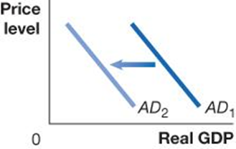

Table 9.1 Variables That Shift the Aggregate Demand Curve (4 of 4)
An increase in … | shifts the aggregate demand curve … | because …
the growth rate of domestic G D P relative to the growth rate of foreign G D P | On a graph, X is real G D P, and Y is price level. Line A D sub 1 shifts left and becomes A D sub 2. | imports will increase faster than exports, reducing net exports.
the exchange rate (the value of the dollar) relative to foreign currencies | On a graph, X is real G D P, and Y is price level. Line A D sub 1 shifts left and becomes A D sub 2. | imports will rise and exports will fall, reducing net exports.
If the growth rate of domestic GDP increases relative to GDP in other countries, Canadian imports will increase faster than Canadian exports making net exports fall.
If our exchange rate rises, our exports become more expensive, so foreigners buy less of them (and we buy more imports, also).

Slide 14
Aggregate Supply
9.2 Learning Objective
Identify the determinants of aggregate supply and distinguish between a movement along the short-run aggregate supply curve and a shift of the curve.
Aggregate supply refers to the quantity of goods and services that firms are willing and able to supply.
The relationship between this quantity and the price level is different in the long run and short run.
We will develop here both a short-run and long-run aggregate supply curve.
Long-run aggregate supply (LRAS) curve: A curve that shows the relationship in the long run between the price level and the quantity of real GDP supplied.

Slide 15
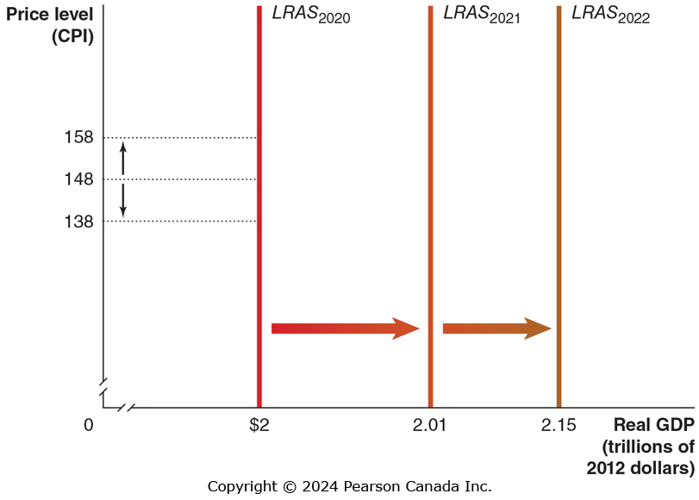
Figure 9.2 Long-Run Aggregate Supply Curve
In the long run, the level of real GDP is determined by the number of workers, the level of technology, and the capital stock (factories, machinery, etc.).
None of these elements is affected by the price level, so LRAS does not depend on the price level; it is a vertical line.
LRAS occurs at the level of potential or full-employment GDP, which advances each year.

Slide 16
Short-Run Aggregate Supply (SRAS) Curve
While the LRAS is vertical, the SRAS is upward sloping. Why?
As prices of final goods and services rise, prices of inputs—such as the wages of workers or the price of natural resources—rise more slowly.
A secondary reason is that some firms are slow to adjust their prices when the price level rises or falls.
Economists tend to believe that some firms and workers fail to accurately predict changes in the price level.
Based on this, there are three potential explanations for why the SRAS curve is upward-sloping:
Contracts make some wages and prices “sticky”
Firms are often slow to adjust wages
Menu costs make some prices sticky

Slide 17
Why is the SRAS Curve Upward Sloping?
Contracts make some wages and prices “sticky”
Prices and wages are said to be “sticky” when they do not respond quickly to changes in demand or supply.
Some firms and workers fail to predict price level changes, and hence do not correctly build them into long-term contracts.
Firms are often slow to adjust wages
Annual salary reviews are “normal”, for example.
Also, firms dislike cutting wages—it’s bad for morale.
Menu costs make some prices sticky
Altering prices is sometimes costly in itself. Firms have menu costs when it costs them money to change prices, for example by having to print new catalogs. A small “optimal” change in price may not be worth the hassle for a firm to perform.

Slide 18
Shifts of the SRAS Curve vs. Movements Along It
The short-run aggregate supply curve describes the relationship between the price level and the quantity of goods and services firms are willing to supply, holding constant all other variables that can affect the willingness of firms to supply goods and services.
If the price level changes, but nothing else does, the economy will move up or down along a stationary SRAS curve.
But some factors cause the SRAS curve to shift; we will consider them in turn.

Slide 19
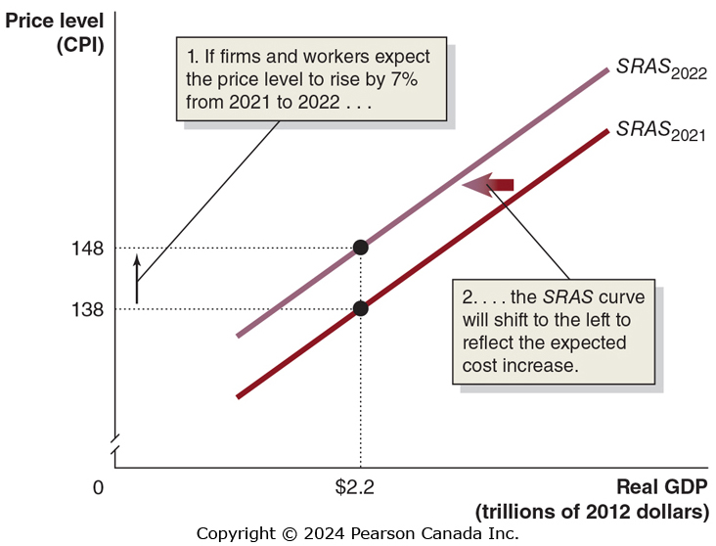
Figure 9.3 How Expectations of the Future Price Level Affect the Short-Run Aggregate Supply Curve
If workers and firms believe the price level will rise by a certain amount, say 3 percent, they will try to adjust their wages and prices accordingly.
Holding constant all other variables that affect aggregate supply, the SRAS will shift to the left.
Widely held expectations of future price-level increases are self-fulfilling!

Slide 20
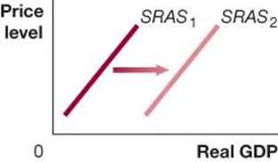

Table 9.2 Variables That Shift the Short-Run Aggregate Supply Curve (1 of 3)
An increase in … | shifts the short-run aggregate supply curve … | because …
the labour force or the capital stock | On a graph, X is real G D P, and Y is price level. Line S R A S sub 1 shifts right and becomes S R A S sub 2. | more output can be produced at every price level.
productivity | On a graph, X is real G D P, and Y is price level. Line S R A S sub 1 shifts right and becomes S R A S sub 2. | costs of producing output fall.
An increase in the availability of the factors of production, i.e. labour and capital, allows more production at any price level.
A decrease in the availability of these factors decreases S R A S.
Improvements in technology allow productivity to improve, and hence the level of production at any given price level.
Notes:
Long Description:
The table shows two cases for shift in short-run aggregate supply curves. The line graphs have real GDP marked along the horizontal axis, and price level along the vertical axis.
Case 1: The data in the first column reads “the labor force or the capital stock.” The second column shows a line graph that shows shift in short-run aggregate supply curve. There are two parallel lines that are like backward slash across this graph. The inclined line on the right side is faded and is named SRAS sub 2, and that on the left side is dark and is named SRAS sub 1. There is an arrow to the right, between the two inclined parallel lines. The third column of the table reads “more output can be produced at every price level.”
Case 2: The data in the first column reads “productivity.” The second column shows a line graph that shows shift in short-run aggregate supply curve. There are two parallel lines that are like backward slash across this graph. The inclined line on the right side is faded and is named SRAS sub 2, and that on the left side is dark and is named SRAS sub 1. There is an arrow to the right, between the two inclined parallel lines. The third column of the table reads “costs of production fall.”

Slide 21
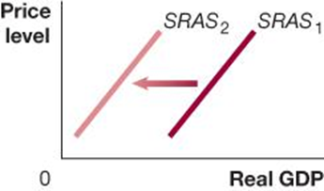

Table 9.2 Variables That Shift the Short-Run Aggregate Supply Curve (2 of 3)
An increase in … | shifts the short-run aggregate supply curve … | because …
the expected future price level | On a graph, X is real G D P, and Y is price level. Line S R A S sub 1 shifts left and becomes S R A S sub 2. | workers and firms increase wages and prices.
The rate at which workers and firms adjust to under-estimating past price level increases | On a graph, X is real G D P, and Y is price level. Line S R A S sub 1 shifts left and becomes S R A S sub 2. | workers and firms increase wages and prices.
If workers and firms expect higher prices in the future, S R A S shifts to the left. This could happen because:
Inflation expectations increase or
Workers and firms realize they previously underestimated the price level.
Notes:
The SRAS curve shifts to reflect workers’ and firms’ expectations of future prices.
1. If workers and firms expect that the price level will rise by 3 percent, from 130 to 134, they will adjust their wages and prices by that amount.
2. Holding constant all other variables that affect aggregate supply, the short-run aggregate supply curve will shift to the left. If workers and firms expect that the price level will be lower in the future, the short-run aggregate supply curve will shift to the right.
Long Description:
• The line graph with the x-axis labeled real GDP in trillions of 2012 dollars and the y-axis labeled price level in CPI. A line labeled cap SRAS sub 2018 forms an upward slope with a point (2, 130) lying on it. A line labeled cap SRAS sub 2019 with a point (2, 134) forms an upward slope lying outward and parallel to the line SRAS sub 2018.
• An arrow flows from the line SRAS sub 2018 to the line SRAS sub 2019 with a note that reads “2. The SRAS curve will shift to the left to reflect the expected cost increase.”. An arrow flows from the point (0, 130) to the point (0, 134) with a note that reads “1. If firms and workers expect the price level to rise by 3% from 2018 to 2019”.
The data in the first column reads “the expected future price level.” The second column shows a line graph that shows shift in short-run aggregate supply curve. There are two parallel lines that are like backward slash across this graph. The inclined line on the right side is dark and is named SRAS sub 1, and that on the left side is faded and is named SRAS sub 2. There is an arrow to the left, between the two inclined parallel lines. The third column of the table reads “workers and firms increase wages and prices.”

Slide 22
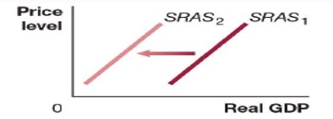
Table 9.2 Variables That Shift the Short-Run Aggregate Supply Curve (3 of 3)
An increase in … | shifts the short-run aggregate supply curve … | because …
the expected price of a key natural resource | On a graph, X is real G D P, and Y is price level. Line S R A S sub 1 shifts left and becomes S R A S sub 2. | costs of production rise.
A supply shock is an unexpected event that causes the short-run aggregate supply curve to shift.
Examples: Oil prices increase suddenly. Firms immediately anticipate rising input prices and will only produce the same amount of output if their own prices rise. The pandemic shutdown closed businesses and reduced supply in 2020.
Unexpected input price increases cause a decrease in the S R A S; unexpected input price decreases would shift S R A S to the right instead.
Notes:
Long Description:
The data in the first column reads “the expected price of a key natural resource.” The second column shows a line graph that shows shift in short-run aggregate supply curve. There are two parallel lines that are like backward slash across this graph. The inclined line on the right side is dark and is named SRAS sub 1, and that on the left side is faded and is named SRAS sub 2. There is an arrow to the left, between the two inclined parallel lines. The third column of the table reads “costs of production rise.”

Slide 23
Macroeconomic Equilibrium in the Long Run and the Short Run
9.3 Learning Objective
Use the aggregate demand and aggregate supply model to illustrate the difference between short-run and long-run macroeconomic equilibrium.
Now we are ready to introduce the long-run aggregate supply curve into our model.
Remember, the LRAS shows the level of potential, or full-employment, GDP.

Slide 24
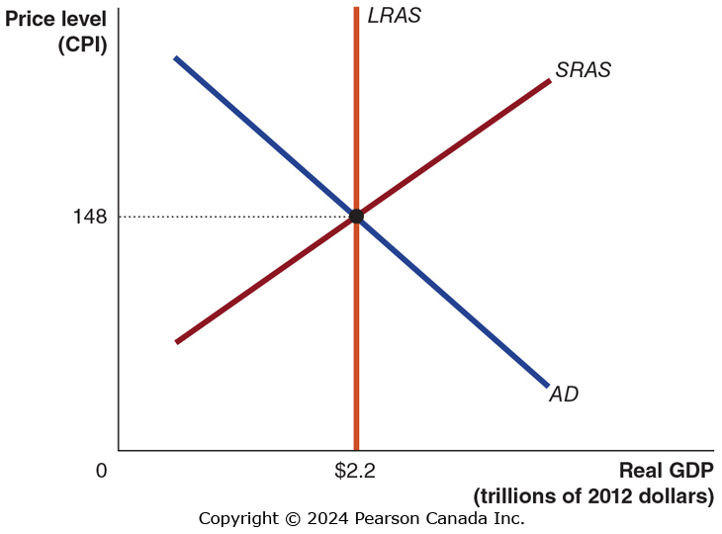
Figure 9.4 Long-Run Macroeconomic Equilibrium
In the long run, we expect the economy to produce at the level of potential GDP—i.e., the LRAS level.
So the long-run macroeconomic equilibrium occurs when the AD and SRAS curves intersect at the LRAS level.
Our next task is to explain why long-run macroeconomic equilibrium cannot occur at any other level of output.
For simplicity, assume:
No inflation; the current and expected-future price level is 148.
No long-run growth; i.e. the LRAS curve is at $2.2 trillion and will be $2.2 trillion in future.

Slide 25
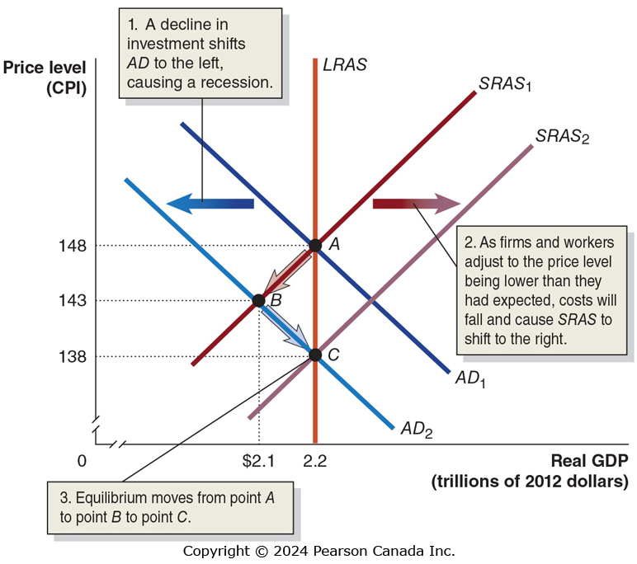
Figure 9.5 The Short-Run and Long-Run Effects of a Decrease in Aggregate Demand (1 of 2)
Suppose that interest rates rise. AD moves left because:
Firms and households reduce their planned investments, decreasing aggregate demand.
Workers lose their jobs, and firms experience decreases in sales.
Notes:
In the short run, a decrease in aggregate demand causes a recession. In the long run, it causes only a decrease in the price level.
Long Description:
• The line graph with the x-axis labeled real GDP in trillions of 2012 dollars is truncated from 0 to 1.96 and ranges till 2.00 at intervals of 0.04. The y-axis labeled price level in CPI is truncated from 0 to 128 and ranges till 134 at intervals of 3.
• A line labeled cap SRAS sub 1 forms an upward slope and a line labeled cap SRAS sub 2 forms an upward slope lying parallel and outward to the line cap SRAS sub 1. An arrow flows from the line cap SRAS sub 1 to the line cap SRAS sub 2 with a note that reads “2. As firms and workers adjust to the price level being lower than they had expected, costs will fall and cause SRAS to shift to the right.”
• A line labeled cap AD sub 1 forms a downward slope intersecting the line cap SRAS sub 1 at a point A (2, 134). A line labeled cap AD sub 2 forms a downward slope intersecting the line cap SRAS sub 1 at a point B (1.96, 131) and intersecting the line cap SRAS sub 2 at a point C (2.00, 128) lying parallel and inward to the line cap AD sub 1. An arrow flows from the line cap AD sub 1 to the line cap AD sub 2 shows a note that reads “1. A decline in investment shifts AD to the left, causing a recession. “The point C shows a note that reads “3. Equilibrium moves from point A to point B to point C.”

Slide 26
Figure 9.5 The Short-Run and Long-Run Effects of a Decrease in Aggregate Demand (2 of 2)
As a result of higher unemployment, workers become willing to accept lower wages, and firms expect lower prices for their output.
So the SRAS curve moves to the right, with goods and services sold for lower prices, until we return to full-employment.

Slide 27
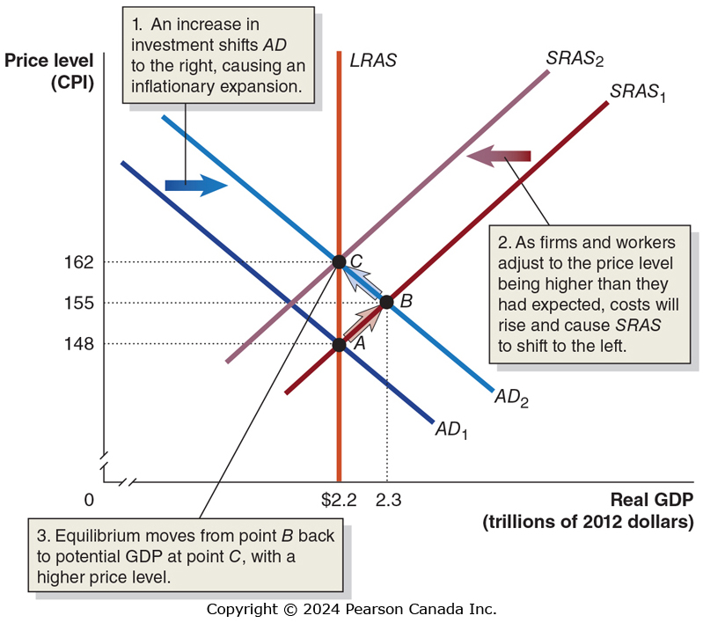
Figure 9.6 The Short-Run and Long-Run Effects of an Increase in Aggregate Demand (1 of 2)
Suppose that firms become more optimistic about the future.
They increase their investment, shifting AD to the right to AD₂
Unemployment falls below its natural rate, forcing employers to pay more; the increased demand for goods raises prices.

Slide 28
Figure 9.6 The Short-Run and Long-Run Effects of an Increase in Aggregate Demand (2 of 2)
Firms and workers raise their expectations about the price level, shifting SRAS to the left—restoring long run equilibrium.

Slide 29
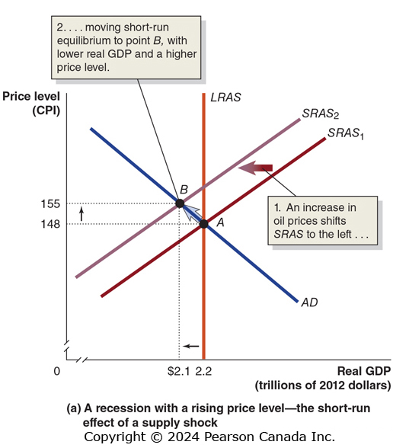
Figure 9.7 The Short-Run and Long-Run Effects of a Supply Shock (1 of 3)
In the previous analyses, AD moved suddenly. What if instead SRAS moved suddenly? We call this a supply shock.
For example, suppose a sudden increase in oil prices shifts SRAS to the left.
This causes stagflation, a combination of inflation and recession, usually resulting from a supply shock.

Slide 30
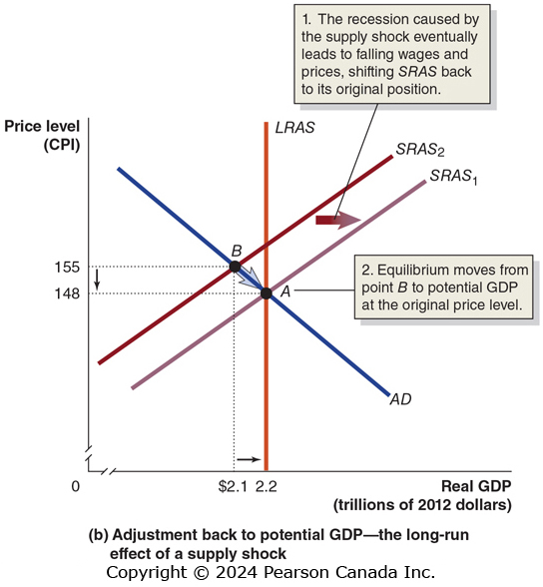
Figure 9.7 The Short-Run and Long-Run Effects of a Supply Shock (2 of 3)
With the lower level of output, people are unemployed and products go unsold.
Workers will be willing to accept lower wages, and firms decrease prices in order to clear inventories.
With the decrease in expectations about prices, SRAS moves back to the right, restoring long-run equilibrium.

Slide 31
Figure 9.7 The Short-Run and Long-Run Effects of a Supply Shock (3 of 3)
How long does it take to restore full employment?
It depends on the severity of the supply shock, but it is likely to take several years.
An alternative to waiting this long is to use fiscal or monetary policy to increase aggregate demand.
This will result in permanently higher prices but may be worth the cost.

Slide 32
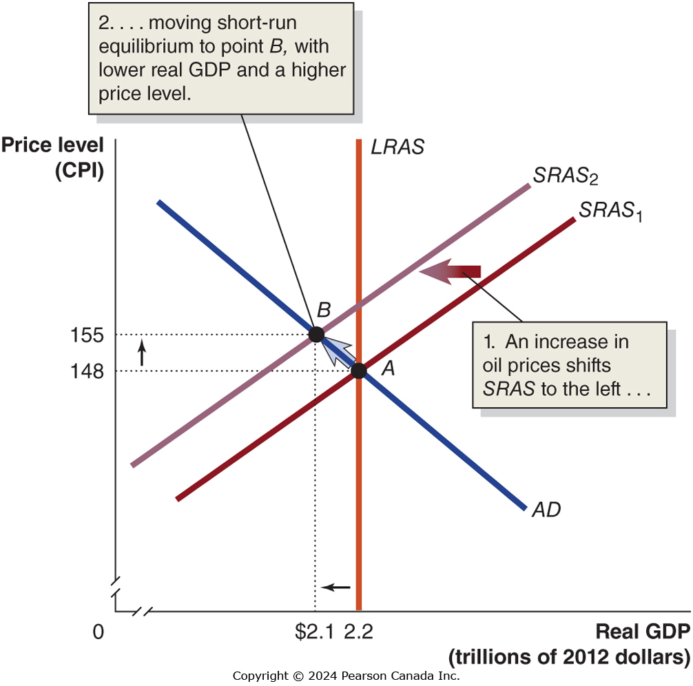
Apply the Concept: Was the 2020 COVID-19 Recession a Supply Shock or a Demand Shock? (1 of 3)
Both supply shocks and demand shocks can cause recessions. So which kind of shock caused the 2020 recession?
A supply shock that closes businesses and increases firms’ costs will shift the short-run aggregate supply curve to the left. The output will fall, and prices will rise.

Slide 33
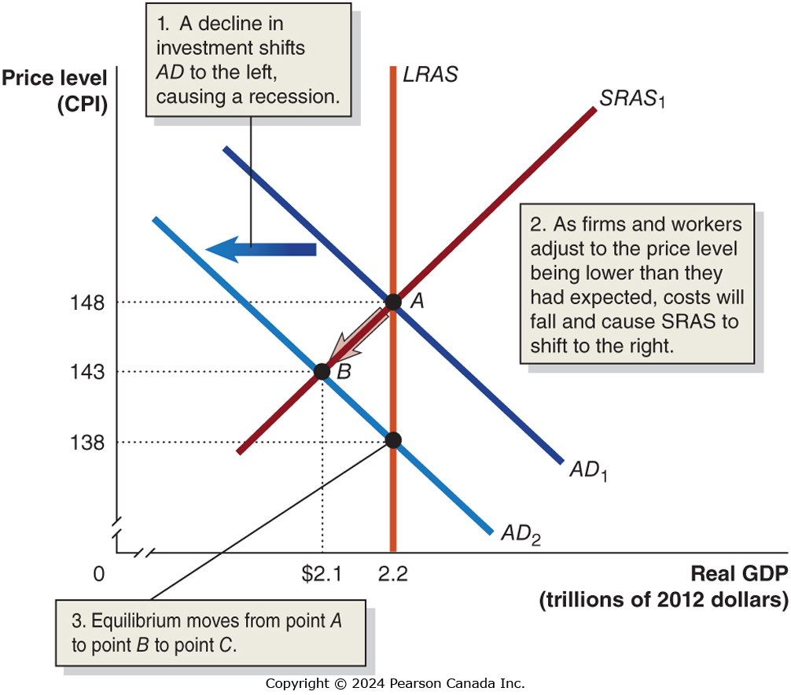
Apply the Concept: Was the 2020 COVID-19 Recession a Supply Shock or a Demand Shock? (2 of 3)
A demand shock that reduces household demand for goods and services will shift the aggregate demand curve to the right. The output will fall, and prices will fall as well.

Slide 34
Apply the Concept: Was the 2020 COVID-19 Recession a Supply Shock or a Demand Shock? (3 of 3)
Recessions caused by either supply or demand shocks see real GDP fall.
This is exactly what we observed in 2020. Real GDP fell in the first two quarters of 2020, from $2.12 trillion at the end of 2019 to $1.85 trillion halfway through 2020.
In January 2020, the seasonally adjusted Consumer Price Index was 137.3. In July 2020, when output had started to recover, the seasonally adjusted Consumer Price Index was 136.7.
This tells us that prices fell during the 2020 recession, suggesting that the shift in aggregate demand played a larger role in the recession of 2020 than the shift in short-run aggregate supply.

